Slide 1

Logarithms Part 3 Applied Electronics
RCET 0264 Introductory Calculus
Tim Leishman

Slide 2
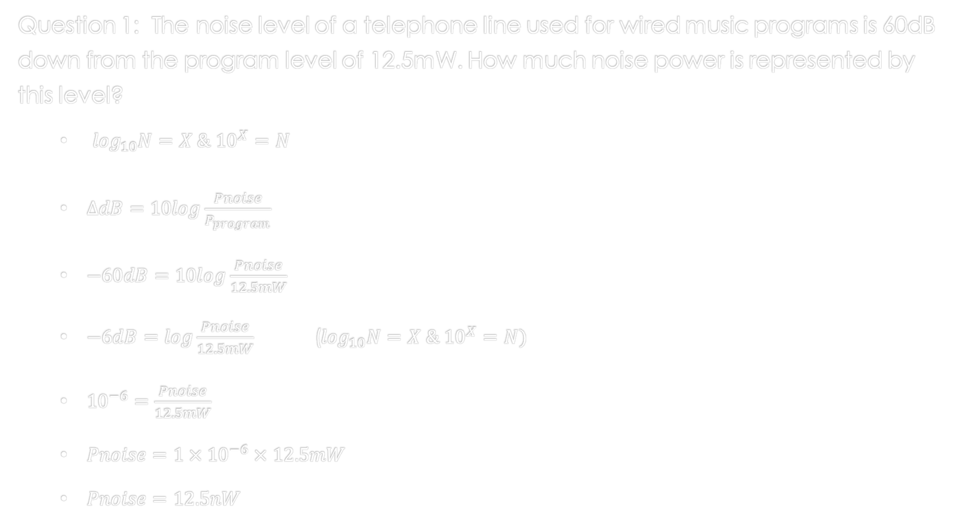
Logarithms Applied Electronics
Question 1: The noise level of a telephone line used for wired music programs is 60dB down from the program level of 12.5mW. How much noise power is represented by this level?
$\log_{10}N=X \& {10}^{X}=N$
$∆dB=10log\frac{Pnoise}{P_{program}}$
$−60dB=10log\frac{Pnoise}{12.5mW}$
$−6dB=log\frac{Pnoise}{12.5mW}$ ($\log_{10}N=X \& {10}^{X}=N)$
${10}^{−6}=\frac{Pnoise}{12.5mW}$
$Pnoise={1×10}^{−6}×12.5mW$
$Pnoise=12.5nW$

Slide 3
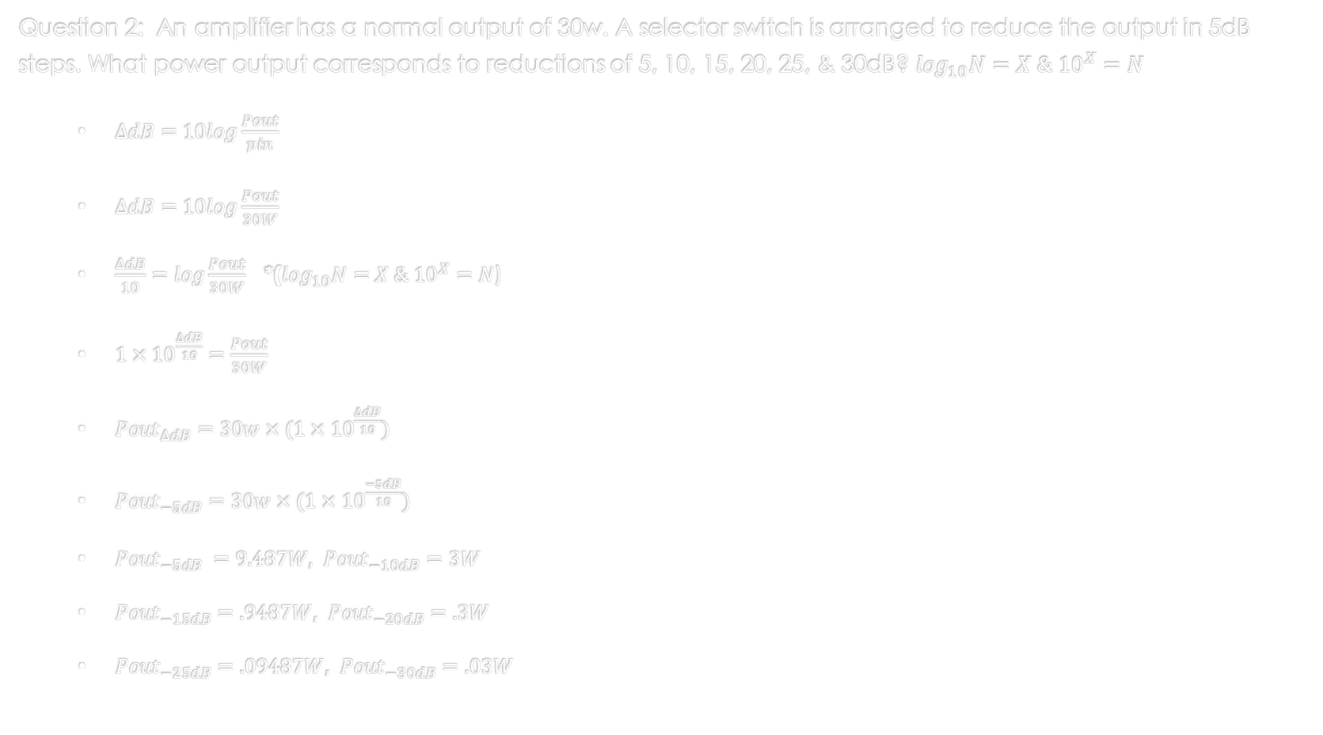
Logarithms Applied Electronics
Question 2: An amplifier has a normal output of 30w. A selector switch is arranged to reduce the output in 5dB steps. What power output corresponds to reductions of 5, 10, 15, 20, 25, & 30dB? $\log_{10}N=X \& {10}^{X}=N$
$∆dB=10log\frac{Pout}{pin}$
$∆dB=10log\frac{Pout}{30W}$
$\frac{∆dB}{10}=log\frac{Pout}{30W}$ *($\log_{10}N=X \& {10}^{X}=N$)
${1×10}^{\frac{∆dB}{10}}=\frac{Pout}{30W}$
${Pout}_{∆dB}=30w×({1×10}^{\frac{∆dB}{10}})$
${Pout}_{−5dB}=30w×({1×10}^{\frac{−5dB}{10}})$
${Pout}_{−5dB} =9.487W, {Pout}_{−10dB}=3W$
${Pout}_{−15dB}=.9487W, {Pout}_{−20dB}=.3W$
${Pout}_{−25dB}=.09487W, {Pout}_{−30dB}=.03W$

Slide 4

Logarithms Applied Electronics
Question 3: A video tuner amplifier has an input impedance of 300Ω and an output impedance of 3.5KΩ. When a 300mV signal is applied at the input, a 250V signal appears at the output.
What is $∆V$?
$∆V=\frac{Vout}{Vin}=\frac{250v}{300mv}$
$∆V=833.333$
What is Pout?
$Pout= \frac{{vout}^{2}}{R}=\frac{{250}^{2}}{3.5KΩ}$
$Pout=17.857 Watts$
What is the gain in dB?
$∆dB=10log\frac{Pout}{Pin}$
$∆dB=10log\frac{17.857}{(\frac{{300mv}^{2}}{300Ω})}$
$∆dB=47.75dB$

Slide 5
References:
Ewen, D., Gary, J. S., & Trefzger, J. E. (2005). Technical calculus. Upper Saddle River, NJ: Pearson/Prentice Hall.
Richmond, A. E., & Hecht, G. W. (1995). Calculus for electronics. New York: Glence.

